Slide 1
Sales Export Analysis :- Sharma multistores
Yashraj Dangre

Slide 2
Introduction :-
Welcome to the sales export report of Sharma Multistores. We are comparing data of different product categories and destinations of 2019 and 2020. This report offers insights into our international sales performance to help in strategic decision-making for global expansion.
Objective :-
Analysing the sales exports of India to create sales report for year 2019 -2020.
Understand the customers to increase the sales in the coming years.

Slide 3
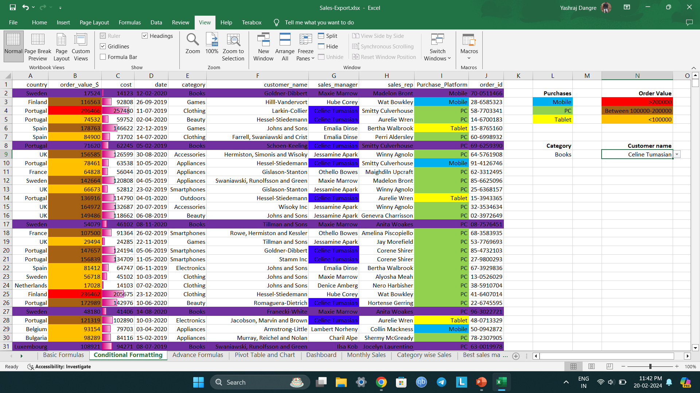
Conditional Formatting

Slide 4
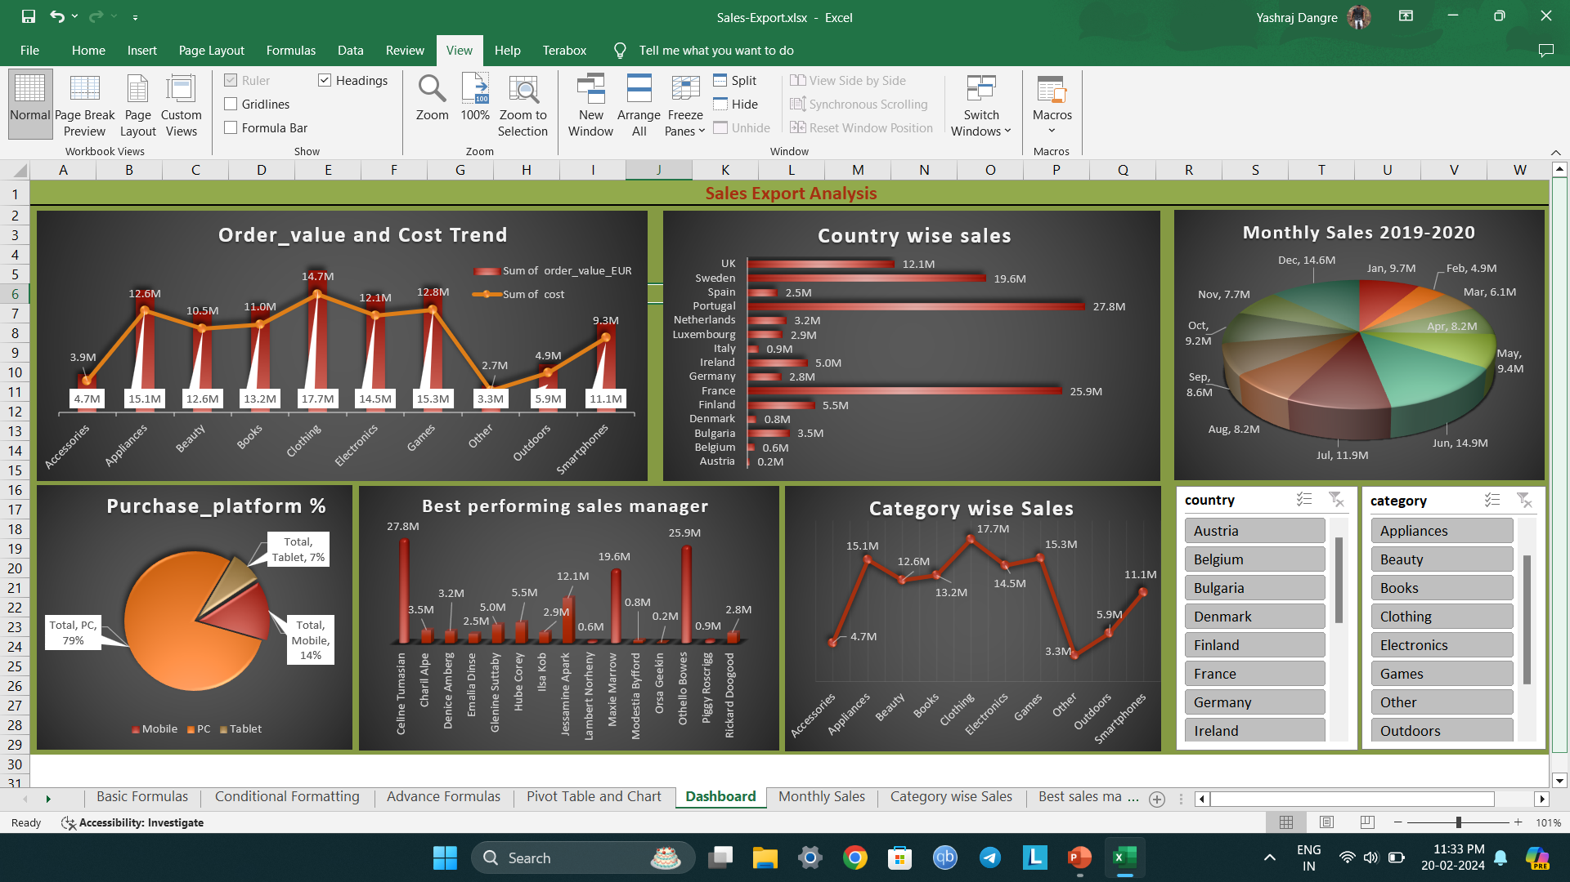

Slide 5
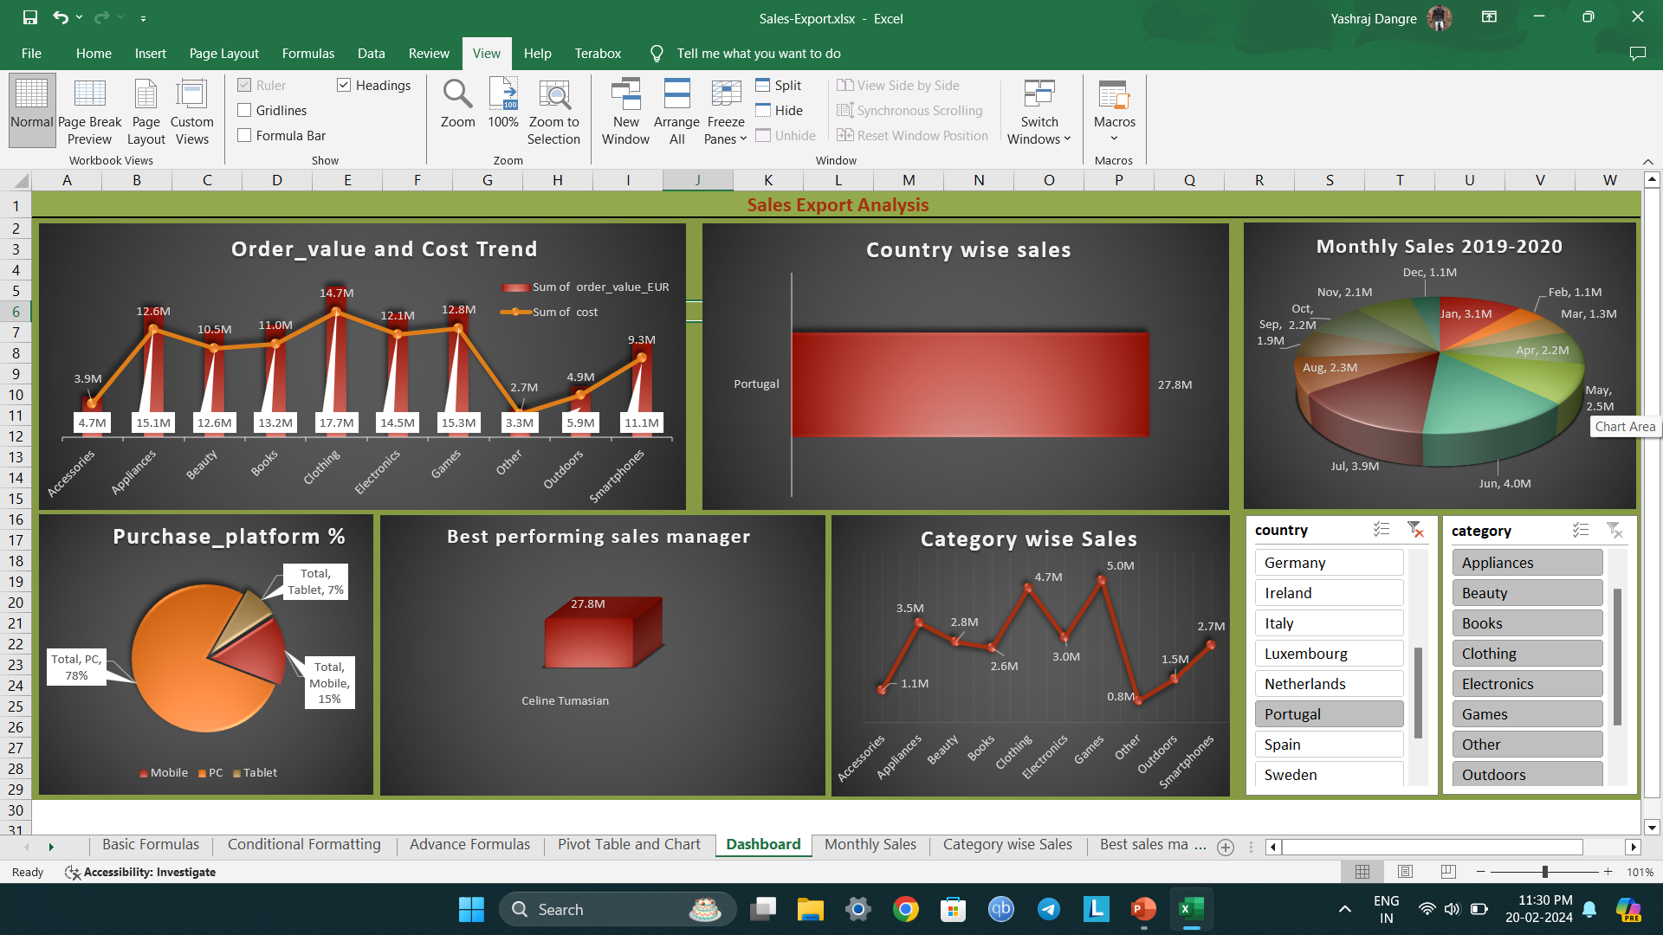

Slide 6
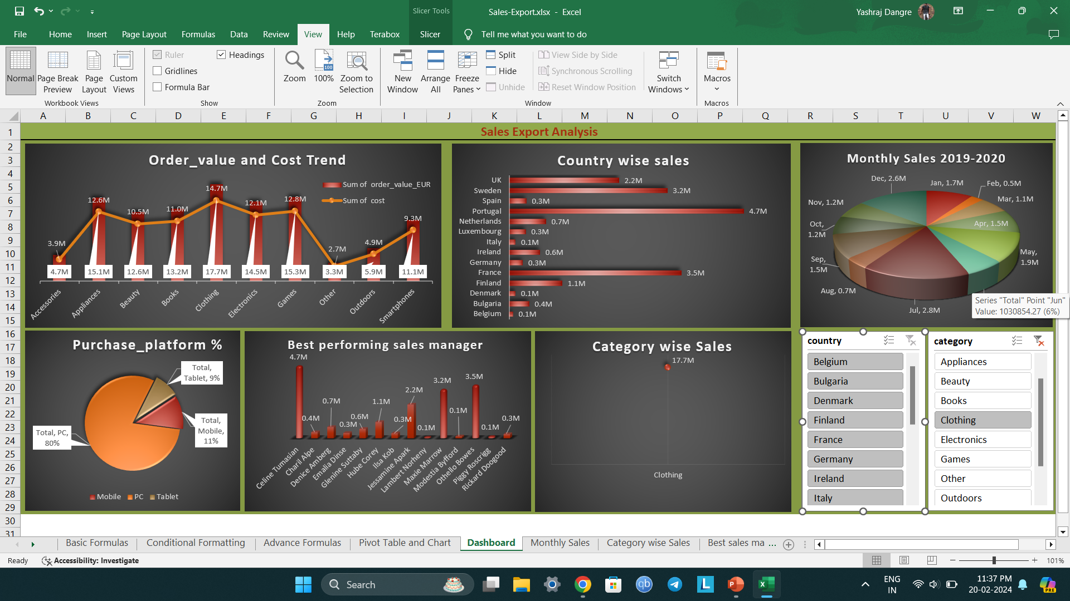

Slide 7
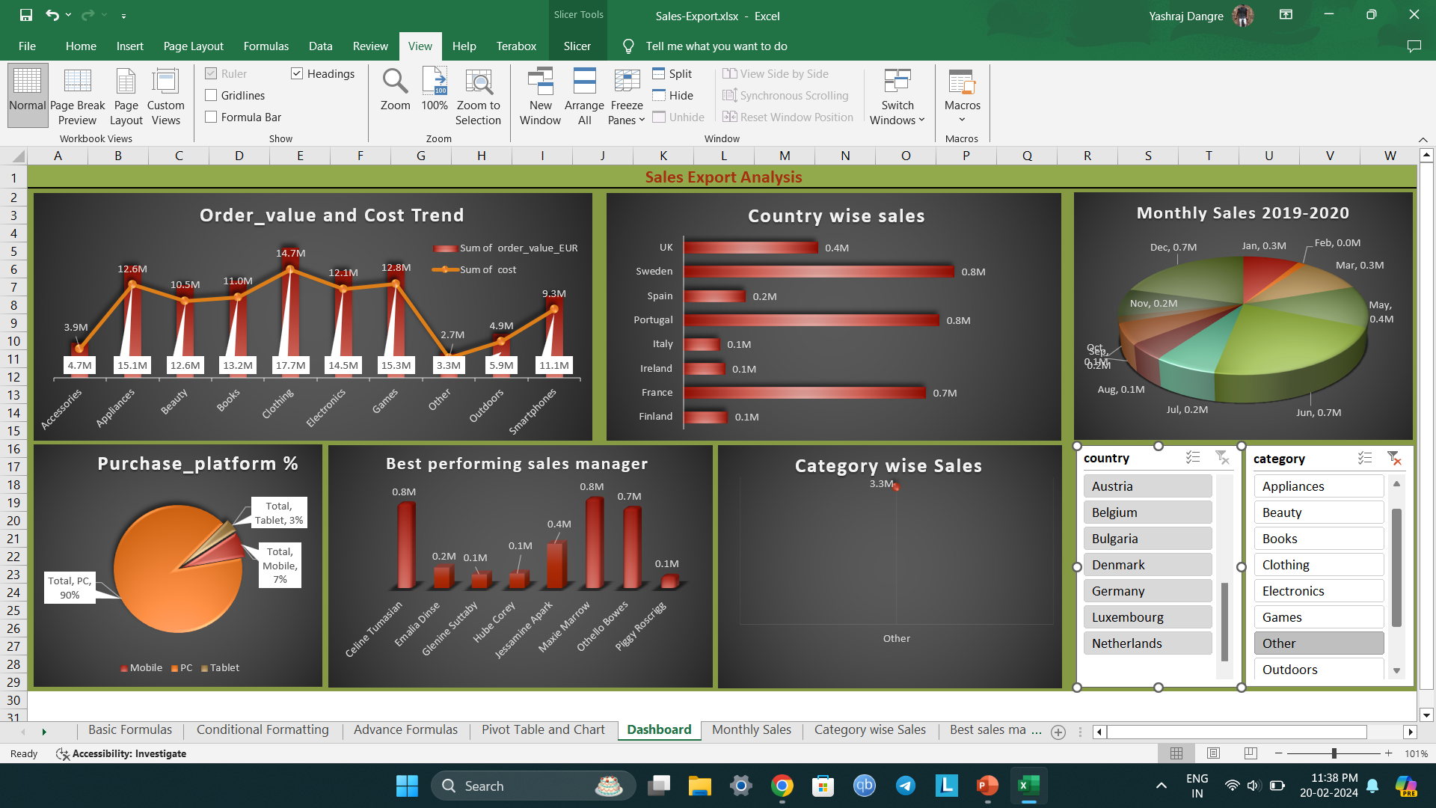

Slide 8
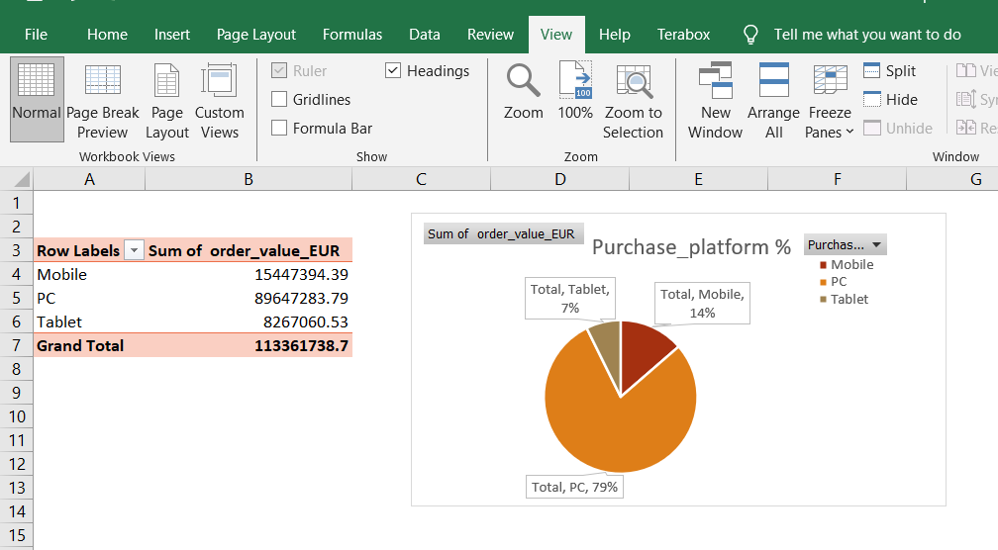
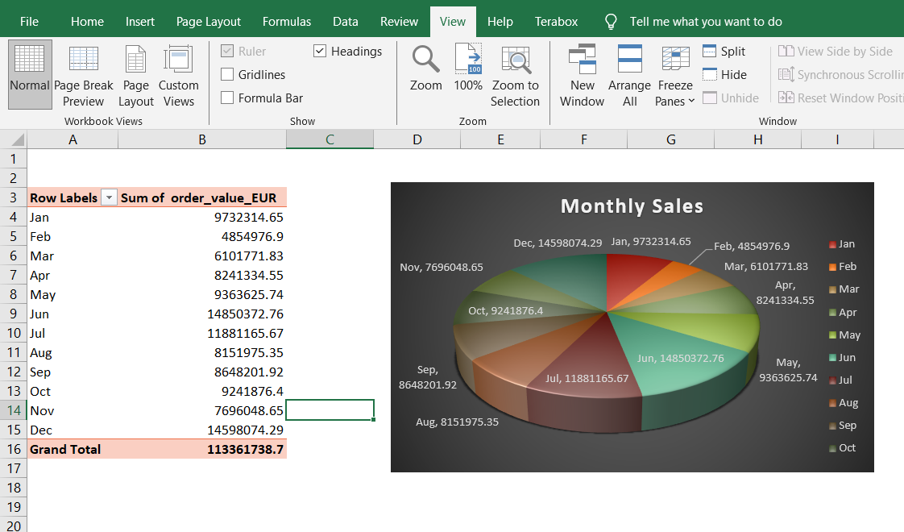

Slide 9
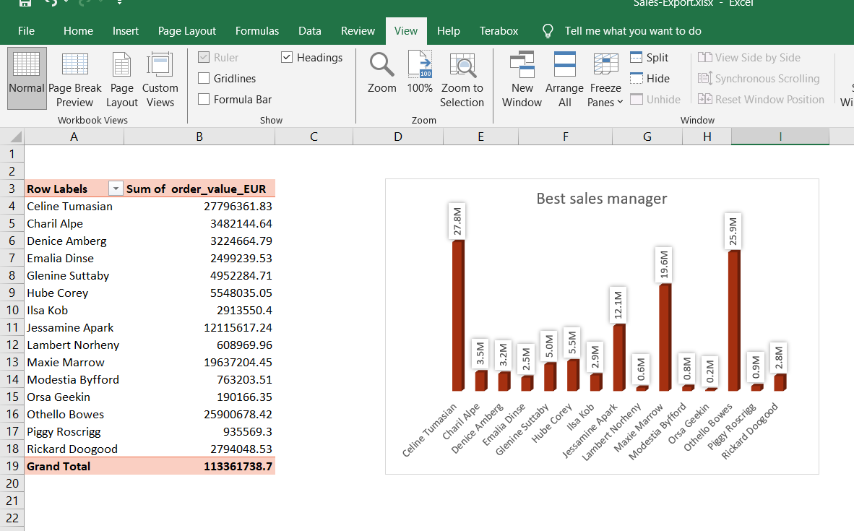
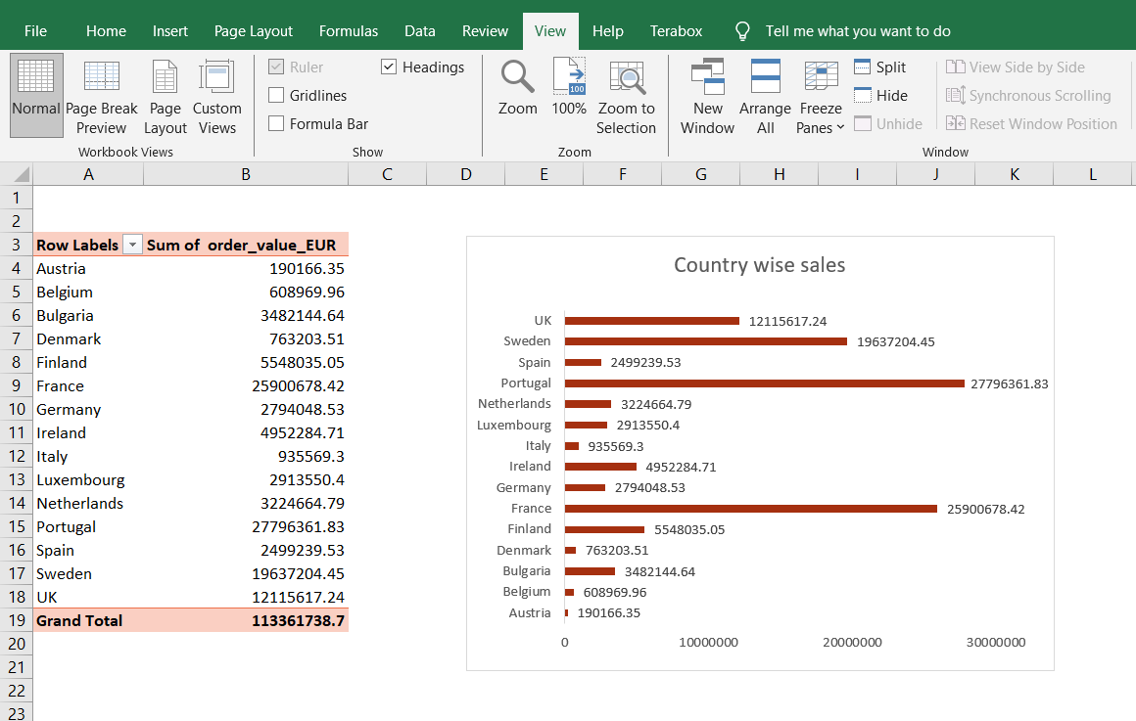

Slide 10
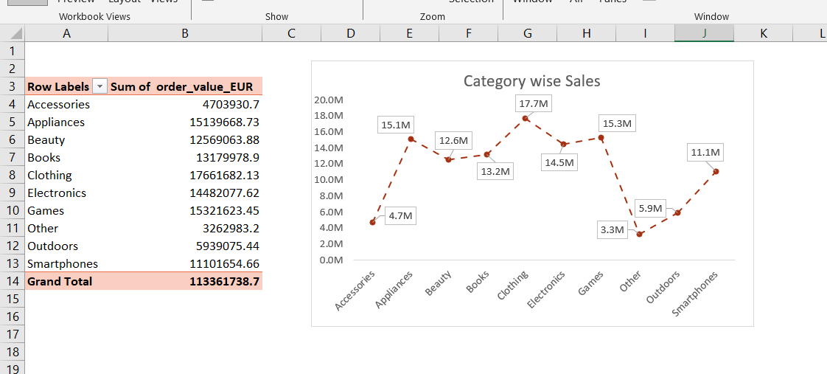
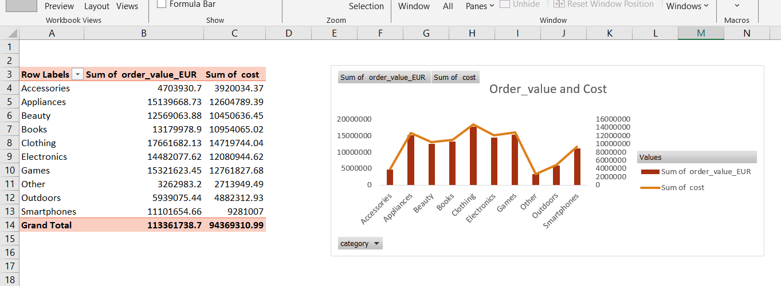

Slide 11
Data Insights
Total Order Value of products export :- $ 11,33,61,738.71
Total number of customers :- 1000
Average cost of products sold :- $ 94369.31099
Maximum Order value of one time :- $ 3,83,996.76
Country with highest sales :- Portugal ($ 27796361.83)
Most sold product :- Clothing ($ 17661682.13)
Most used platform for purchases :- PC ($ 89647283.79)
Best performing Sales Manager :- Celine Tumasian.

Slide 12
Final Conclusion :-
Target customers of Portugal, France and Sweden for selling clothes and increasing profits.
Focus on low performing managers to help them create more sales.
Conduct more AD-campaigns and promotion of accessories and outdoor products to increase sales.

